Slide 1

Computing Algorithms Lecture 9: Divide and Conquer
By: Dr. Mohamed Moheeb

Slide 2
Agenda
Introduction
Merge sort
Quick sort
Binary tree traversal

Slide 3

Introduction

Slide 4
What is Divide and Conquer?
Divide and Conquer is an algorithm design paradigm based on multi-branched recursion.
It works by breaking down a problem into three distinct steps:
Divide: Break the given problem into smaller sub-problems of the same type.
Conquer: Recursively solve these sub-problems. (If the sub-problem is small enough, solve it directly as a base case).
Combine: Appropriately combine the answers of the sub-problems to get the exact solution to the original problem.

Slide 5
Merge sort

Slide 6
Merge sort
Merge Sort continuously cuts the array in half until it cannot be divided further (arrays of 1 element).
Then, it repeatedly merges the sub-lists to produce new sorted sub-lists until there is only one sorted list remaining.

Slide 7
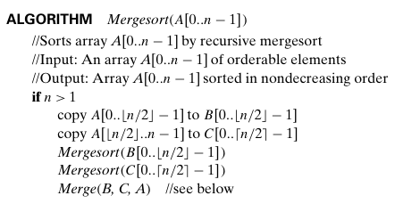
Merge sort
Let’s trace Merge Sort on a given array of size n=5.
Initial Array: [ 38, 27, 43, 3, 9 ]
The first condition check if the size of array is equal to 1 or not
The array will be divided into two parts from A[0…1] in new array B= [38,27]
The second part is from A[2…..4] in new array C=[43,3,9]
Note that the array B has index starting from 0 till 2-1 and C has an index staring from 0 till 3-1
The mergesort() function is called again with array B ( this is the divide process)
Another note this is a recursive function so when we finish the mergesort(B) we will continue with mergesort(C) second part of the array

Slide 8
Merge sort
Let’s consider applying the merge on array B= [38,27]
First let’s check if the size is greater than 1 which is equal 2
we divide it into two parts B and C to avoid confusion let call it B1 and C1
B1=[38] and C1=[27]
We are going to call mergesort(B1)

Slide 9
Merge sort
Let’s consider applying the merge on array B1=[38]
First let’s check if the size is greater than 1 which is equal 1 we return to the pervious call.

Slide 10
Merge sort
We are back to the call where we called merge sort on B= [38,27]
Where we have two arrays B1=[38] and C1=[27]
We are going to call mergesort(C1)

Slide 11
Merge sort
Let’s consider applying the merge on array C1=[27]
First let’s check if the size is greater than 1 which is equal 1 we return to the pervious call.

Slide 12
Merge sort
We are back to the call where we called merge sort on B= [38,27]
Where we have two arrays B1=[38] and C1=[27]
We now finished the calls for mergesort() for both C1 and B1 (divide)
We are going to call Merge(B,C,A) or in this call Merge(B1,C1,B)

Slide 13
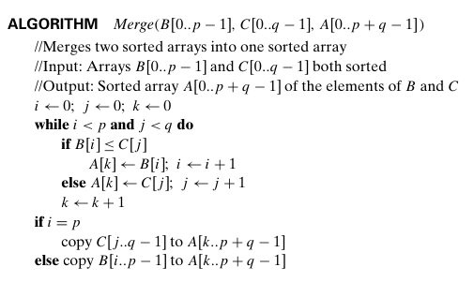
Merge sort
In this function p is the size of array B and q is the size of array C and A size is p+q
The index i is for B array, j is for C array and k is for A array.
in this call B is B1, C is C1 and A is B
To avoid confusion let’s call the arrays B1 and C1 and A
Where we have two arrays B1=[38] and C1=[27]
Variables
i=0
j=0
k=0
p=1
q=1

Slide 14
Merge sort
The while condition check if any index of I or j exceeds the the size of p and q
Where i is less than 1 and j is less than q
Variables
i=0
j=0
k=0
p=1
q=1

Slide 15
Merge sort
B1=[38] and C1=[27]
Let check the condition if B[0] < C[0] or 38<27 which is false we move to the else part
Variables
i=0
j=0
k=0
p=1
q=1

Slide 16
Merge sort
B1=[38] and C1=[27]
A[0]= 27 and then we increment j index by 1
Variables
i=0
j=1
k=0
p=1
q=1

Slide 17
Merge sort
B1=[38] and C1=[27] A=[27, ]
then we increment k index by 1
Variables
i=0
j=1
k=1
p=1
q=1

Slide 18
Merge sort
Recheck the condition the j is equal to q so we move to next step after the while loop
Variables
i=0
j=1
k=1
p=1
q=1

Slide 19
Merge sort
This part is to copy the remaining elements from either array B or C to array A
If i is equal to p this means that the remaining elements is in array C and else the remaining elements are in array B
In in our case now, i is not equal to p so we move to the else part
Variables
i=0
j=1
k=1
p=1
q=1

Slide 20
Merge sort
B1=[38] and C1=[27] A=[27, ]
We copy elements from Array B1 starting from index i=0 till p-1=0 to the remaining parts of array A staring form k=1 till the end of array p+q-1=1+1-1=1 So A[1..1]=B1[0…0]
final array A=[27,38]
In latest stages it will be clearer
Note A=B=[27,38]
We now finished Merge of B is the last line in the mergesort(B) function where do we go now ?
Variables
i=0
j=1
k=1
p=1
q=1

Slide 21
Merge sort
Initial Array: A= [ 38, 27, 43, 3, 9 ]
new array B= [27,38]
Now it is C turn = [43,3,9]

Slide 22
Merge sort
C= [43,3,9]and its size is larger than 1
Let’s divide it into two arrays B and C or let’s call them B2 and C2
B2=[43]
C2=[3,9]
Let’s call the mergesort(B2)

Slide 23
Merge sort
B2=[43] and its size is equal to 1
We return to the pervious recursive call

Slide 24
Merge sort
C= [43,3,9] B2=[43] C2=[3,9]
It the turn to call the mergesort(C2)

Slide 25
Merge sort
C2= [3,9]and its size is larger than 1
Let’s divide it into two arrays B and C or let’s call them B3 and C3
B3=[3]
C3=[9]
Let’s call the mergesort(B3)

Slide 26
Merge sort
B3=[3] and its size is equal to 1
We return to the pervious recursive call

Slide 27
Merge sort
C2= [3,9] B3=[3] C3=[9]
Let’s call the mergesort(C3)

Slide 28
Merge sort
C3=[9] and its size is equal to 1
We return to the pervious recursive call

Slide 29
Merge sort
C2= [3,9] B3=[3] C3=[9]
We reached the Merge part which means that we finished the divide part and we need to conquer using merge(B3,C3,C2)

Slide 30
Merge sort
in this call B is B3, C is C3and A is C2
To avoid confusion let’s call the arrays B3 and C3 and A
Where we have two arrays B3=[3] and C3=[9]
Variables
i=0
j=0
k=0
p=1
q=1

Slide 31
Merge sort
The while condition check if any index of I or j exceeds the the size of p and q
Where i is less than 1 and j is less than q
Variables
i=0
j=0
k=0
p=1
q=1

Slide 32
Merge sort
B3=[3] and C3=[9]
Let check the condition if B[0] < C[0] or 3<9 which is true.
Variables
i=0
j=0
k=0
p=1
q=1

Slide 33
Merge sort
B3=[3] and C1=[9]
A[0]= 3 and then we increment i index by 1
Variables
i=1
j=0
k=0
p=1
q=1

Slide 34
Merge sort
B1=[3] and C1=[9] A=[3, ]
then we increment k index by 1
Variables
i=1
j=0
k=1
p=1
q=1

Slide 35
Merge sort
Recheck the condition the i is equal to p so we move to next step after the while loop
Variables
i=1
j=0
k=1
p=1
q=1

Slide 36
Merge sort
This part is to copy the remaining elements from either array B or C to array A
If i is equal to p this means that the remaining elements is in array C and else the remaining elements are in array B
In in our case now, i is equal to p
Variables
i=1
j=0
k=1
p=1
q=1

Slide 37
Merge sort
B3=[3] and C3=[9] A=[3, ]
We copy elements from Array C3 starting from index j=0 till q-1=0 to the remaining parts of array A staring form k=1 till the end of array p+q-1=1+1-1=1 So A[1..1]=C3[0…0]
final array A=[3,9]
In latest stages it will be clearer
Note A=C3=[3,9]
We now finished Merge of C2.
Variables
i=1
j=0
k=1
p=1
q=1

Slide 38
Merge sort
C= [43,3,9] B2=[43] C2=[3,9]
Now after finishing C2 merge we are back to this recursive call
Now it time to merge B2 and C2 to produce the sorted C
We call Merge(B2,C2,C)

Slide 39
Merge sort
in this call B is B2, C is C2 and A is C
To avoid confusion let’s call the arrays B3 and C3 and A
Where we have two arrays B2=[43] and C3=[3,9]
Let’s move a let bit faster follow the arrow
Variables
i=0
j=0
k=0
p=1
q=2

Slide 40
Merge sort
B2=[43] C2=[3,9]
i<p (0<1) and j<p (0<2) true
Variables
i=0
j=0
k=0
p=1
q=2

Slide 41
Merge sort
B2=[43] C2=[3,9] A=[3, , ]
A[0]=C[0] =3
j+1=1
Variables
i=0
j=1
k=0
p=1
q=2

Slide 42
Merge sort
B2=[43] C2=[3,9] A=[3, , ]
k+1=1
Variables
i=0
j=1
k=1
p=1
q=2

Slide 43
Merge sort
B2=[43] C2=[3,9] A=[3, , ]
i<p (0<1) and j<p (1<2) true
Variables
i=0
j=1
k=1
p=1
q=2

Slide 44
Merge sort
B2=[43] C2=[3,9] A=[3, , ]
B[0]<=C[1] or 43<=9 which is false
Variables
i=0
j=1
k=1
p=1
q=2

Slide 45
Merge sort
B2=[43] C2=[3,9] A=[3, 9 , ]
A[1]=C[1]=9
j+1=2
Variables
i=0
j=2
k=1
p=1
q=2

Slide 46
Merge sort
B2=[43] C2=[3,9] A=[3, 9 , ]
k+1=2
Variables
i=0
j=2
k=1
p=1
q=2

Slide 47
Merge sort
B2=[43] C2=[3,9] A=[3, 9 , ]
i<p (0<1) and j<p (2<2) false
Variables
i=0
j=2
k=1
p=1
q=2

Slide 48
Merge sort
B2=[43] C2=[3,9] A=[3, 9 , ]
i=p is false
Variables
i=0
j=2
k=1
p=1
q=2

Slide 49
Merge sort
B2=[43] C2=[3,9] A=[3, 9 , 43 ]
Copy from B2[i….p-1] to A[k….p+q-1]
A[2..2]=B2[0…0]
Now we finished the merge of C which is equal to A in this function call
Variables
i=0
j=2
k=1
p=1
q=2

Slide 50
Merge sort
We are back to this call function where B= [27,38] and new C is equal to [3,9,43]
We call for the last time Merge(B,C,A)

Slide 51
Merge sort
B= [27,38] C=[3,9,43]
Variables
i=0
j=0
k=0
p=2
q=3

Slide 52
Merge sort
B= [27,38] C=[3,9,43] A=[ , , , , ]
i < p (0<2) and j<q (0<3) true
Variables
i=0
j=0
k=0
p=2
q=3

Slide 53
Merge sort
B= [27,38] C=[3,9,43] A=[ , , , , ]
B[0]<=C[0] (27<3) false
Variables
i=0
j=0
k=0
p=2
q=3

Slide 54
Merge sort
B= [27,38] C=[3,9,43] A=[ 3, , , , ]
A[0]=C[0]=3
j+1=1
Variables
i=0
j=1
k=0
p=2
q=3

Slide 55
Merge sort
B= [27,38] C=[3,9,43] A=[ 3, , , , ]
k+1=1
Variables
i=0
j=1
k=1
p=2
q=3

Slide 56
Merge sort
B= [27,38] C=[3,9,43] A=[ 3, , , , ]
i < p (0<2) and j<q (1<3) true
Variables
i=0
j=1
k=1
p=2
q=3

Slide 57
Merge sort
B= [27,38] C=[3,9,43] A=[ 3, , , , ]
B[0]<=C[1] (27<9) false
Variables
i=0
j=1
k=1
p=2
q=3

Slide 58
Merge sort
B= [27,38] C=[3,9,43] A=[ 3, 9 , , , ]
A[1]=C[1]=9
j+1=2
Variables
i=0
j=2
k=1
p=2
q=3

Slide 59
Merge sort
B= [27,38] C=[3,9,43] A=[ 3, 9 , , , ]
k+1=2
Variables
i=0
j=2
k=2
p=2
q=3

Slide 60
Merge sort
B= [27,38] C=[3,9,43] A=[ 3, 9 , , , ]
i < p (0<2) and j<q (2<3) true
Variables
i=0
j=2
k=2
p=2
q=3

Slide 61
Merge sort
B= [27,38] C=[3,9,43] A=[ 3, 9 , , , ]
B[0]<=C[2] (27<43) true
Variables
i=0
j=2
k=2
p=2
q=3

Slide 62
Merge sort
B= [27,38] C=[3,9,43] A=[ 3, 9 , 27 , , ]
A[2]=B[0]=27
i+1=1
Variables
i=1
j=2
k=2
p=2
q=3

Slide 63
Merge sort
B= [27,38] C=[3,9,43] A=[ 3, 9 , 27 , , ]
A[2]=B[0]=27
k+1=3
Variables
i=1
j=2
k=3
p=2
q=3

Slide 64
Merge sort
B= [27,38] C=[3,9,43] A=[ 3, 9 , 27 , , ]
i < p (1<2) and j<q (2<3) true
Variables
i=1
j=2
k=3
p=2
q=3

Slide 65
Merge sort
B= [27,38] C=[3,9,43] A=[ 3, 9 , 27 , , ]
B[1]<=C[2] (38<43) true
Variables
i=1
j=2
k=3
p=2
q=3

Slide 66
Merge sort
B= [27,38] C=[3,9,43] A=[ 3, 9 , 27 , 38, ]
A[3]=B[1]=38
i+1=2
Variables
i=2
j=2
k=3
p=2
q=3

Slide 67
Merge sort
B= [27,38] C=[3,9,43] A=[ 3, 9 , 27 , 38, ]
k+1=4
Variables
i=2
j=2
k=4
p=2
q=3

Slide 68
Merge sort
B= [27,38] C=[3,9,43] A=[ 3, 9 , 27 , 38, ]
k+1=4
Variables
i=2
j=2
k=4
p=2
q=3

Slide 69
Merge sort
B= [27,38] C=[3,9,43] A=[ 3, 9 , 27 , 38, ]
i < p (2<2) and j<q (2<3) false
Variables
i=2
j=2
k=4
p=2
q=3

Slide 70
Merge sort
B= [27,38] C=[3,9,43] A=[ 3, 9 , 27 , 38, ]
i=p (2=2) ture
Variables
i=2
j=2
k=4
p=2
q=3

Slide 71
Merge sort
B= [27,38] C=[3,9,43] A=[ 3, 9 , 27 , 38, 43]
Copy C[2….2] to A[4…..4]
Now the Array is sorted
Variables
i=2
j=2
k=4
p=2
q=3

Slide 72
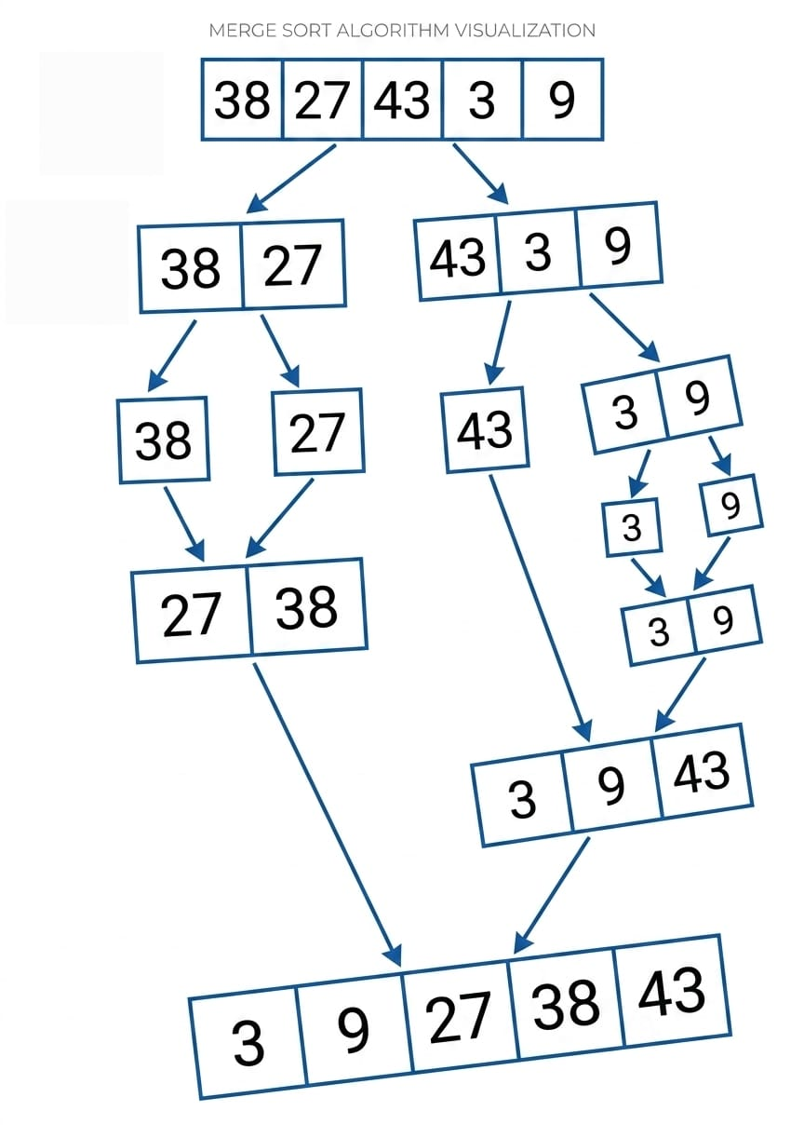
Merge sort (recap)

Slide 73
Merge sort time Analysis
In the divide part the main array of size n is divided into two equal arrays
In the conquer array you almost makes n comparisons in total so the recurrent relationship can be written as follows
T(n)=2T(n/2) +n T(1)=1
After solving it the T(n)= n + n log(n) which is θ(nlogn)
This is faster than other sorting algorithms

Slide 74
Quick Sort

Slide 75
Quick Sort
It is very similar to merge sort
It depends on selecting an element called the pivot
The pivot is used as an anchor where all the elements smaller than should be one it left and bigger than on its right
The pivot is where the array will be divided in the next iteration.
It uses the same array but it always keep track of the start and end of each part by using two indices L and R
Now it is your turn please trace this array [ 38, 27, 43, 3, 9 ]

Slide 76
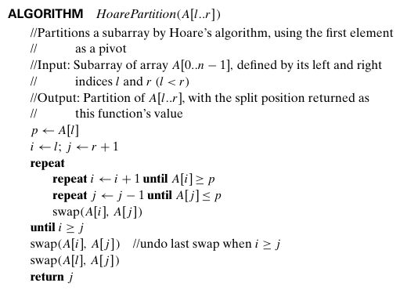
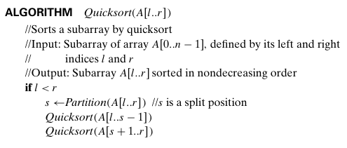
Quick Sort

Slide 77
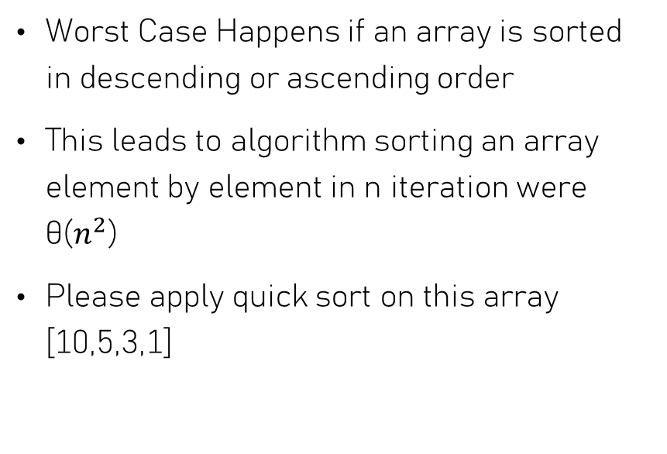
Quick sort Analysis
Average Case:
T(n)= 2T(n/2) +n T(1)=1
Which leads to the same answer as merge sort θ(nlogn)
Worst Case Happens if an array is sorted in descending or ascending order
This leads to algorithm sorting an array element by element in n iteration were θ($n^{2}$)
Please apply quick sort on this array [10,5,3,1]

Slide 78
Binary Tree Traversal

Slide 79
Binary Tree Traversal
It one of important topic in divide and conquer it is used in different application such as compliers (parse trees) and filing system
Tree traversal is the process of visiting each node in a tree data structure, exactly once, in a systematic manner
It has three different types methods:
Preorder: the root is visited before the left and right subtrees are visited (in that order).
Inorder: the root is visited after visiting its left subtree but before visiting the right subtree.
Postorder: the root is visited after visiting the left and right subtrees (in that order).

Slide 80
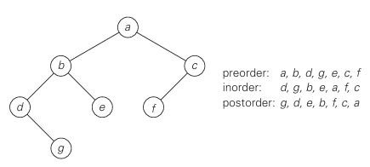
Binary Tree Traversal

Slide 81
Binary Tree Traversal time analysis
All three traversals visit nodes of a binary tree recursively, i.e., by visiting the tree’s root and its left and right subtrees until they visit all of the nodes.
Since they have to cover all the nodes its time complexity is θ(n)

